Slide 1

Norton CEVC Primary School
Parent Information Morning

Slide 2
Learn, Believe and Achieve
Hand in hand with God and each other
This is our vision in the simplest form which the children know and recognise
Be strong and courageous. Do not be afraid; do not be discouraged, for the Lord your God will be with you wherever you go. Joshua 1:9

Slide 3
Our Vision
Learn
Learning is at the forefront of our minds. At Norton CEVC we take pride in developing outstanding teaching and learning by holding the highest expectations for all our pupils and knowing them well. In an ever-changing world, pupils will be equipped with the necessary skills and qualities needed to embrace life’s challenges and opportunities. We will learn about ourselves and others around us both socially, emotionally and spiritually.
Believe
At Norton CEVC we encourage everyone to believe in their own achievements both personally and academically. Through our curriculum, pupils will be opened to a wide range of experiences so that they can develop aspirational attitudes. As a church school we affirm our Christian belief in God with our Christian values being at the heart of our school.
Achieve
‘Achieve’ reflects the importance of achieving academically and celebrating the rewards of hard work and resilience. We also value the many personal achievements that our pupils demonstrate each day; everyone is encouraged to aim high in order to be the best they can be.

Slide 4






Christian Values
Perseverance
Wisdom
Courage
Compassion
Respect
Community

Slide 5

Community
Children
Staff
Parents
Governors

Slide 6

Welcome to
Star Class
Early Years Foundation Stage (EYFS)

Slide 7

Star Class Team
Class Teachers - Mrs Bouttell and Mrs Cole
Ms Wright– Teaching Assistant

Slide 8


How things change from Nursery or Preschool…
The children’s day is more structured. The children have more guidance towards their activities.
Children are expected to sit and concentrate for longer periods.
They are expected to listen when someone else is talking, especially at carpet time.
We organise activities and routines to build independence and confidence.

Slide 9
Expectations for starting school...
Children should be able to go to the toilet independently.
Children should be able to communicate with their friends and adults.
Children should be able to follow simple instructions.

Slide 10


What is the EYFS?
The Early Years Foundation Stage (EYFS) covers the first stage of a child’s care from birth to five years old. It sets the standards to ensure that all children learn and develop, as well as keeping them healthy and safe.
Also included in the EYFS are the seven Areas of Learning.
  Communication and Language
  Personal, Social and Emotional Development
  Physical Development
  Literacy
  Mathematics
  Understanding the World
  Expressive Arts and Design
At the end of the EYFS, there are 17 Early Learning Goals that children are expected to
achieve.

Slide 11


A typical day in Star Class…
8.35 Doors open
8.45 Gate closes
8.35-8.55 Table Activities
9.00 – Register
9.15 – Read Write Inc – phonics/ writing
10.10 – Story and snack
10.20 – Assembly
10.40 – Playtime
10.55 – Maths
12.00 – Lunchtime
1.00 – Register
1.15 – Afternoon learning
3.15 – Home time

Slide 12

Reading
Reading is so important. Once a child can read they can access everything in the Curriculum much more easily.
In Early Years we place phonics and reading as our priority. We will be concentrating on every child learning phonics. When they are ready, we will give them a reading book. Until then they will bring home a story book for you to enjoy with them.
Please try and share a book with your child every night. A little and often approach really reinforces
all those amazing new skills.

Slide 13

The Read Write Inc. Speed Sounds lessons follow a careful progression, with sounds being introduced sequentially in a structured and systematic way. The broad order follows three sets. Set 1 teaches the most common sound-letter correspondences:
m a s d t / i n p g o / c k u b / f e l h sh r / j v y w / th z ch qu x ng nk

Slide 14

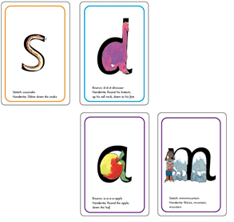
Before you get started please visit… https://www.ruthmiskin.com/en/find-out-more/parents/
to practise saying the sounds clearly. The more clearly you say the sounds, the more quickly your child will learn them.
Your child will bring home the Set 1 Speed Sounds.
You’ll see that each sound is drawn in the shape of a picture. For example:
• ‘s’ is in the shape of a snake
• ‘d’ is in the shape of a dinosaur
• ‘a’ is in the shape of an apple
• ‘m’ is in the shape of two mountains.
Important: We say ‘mmmm’ not ‘muh’ and ‘lllll’ not ‘luh’ when teaching the sounds. This really helps children when they learn to blend sounds together to read words.

Slide 15

Healthy Minds and Bodies
Water bottles – access all day
Each child is offered a healthy morning snack
PE days are on a Tuesday and Wednesday.
PLEASE NAME EVERYTHING!

Slide 16

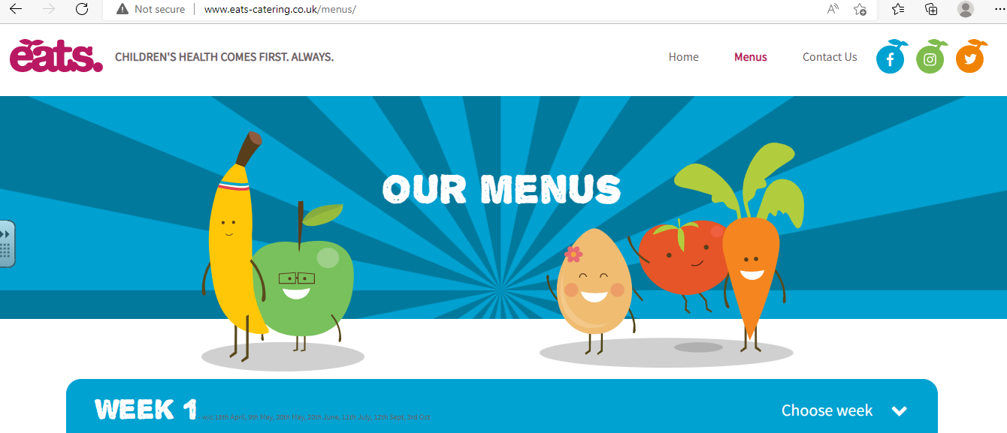
Lunchtime
All children in Reception and Year One and Two can have a free school lunch each day. You can also choose to bring a packed lunch to school if you prefer. Please remember we do not allow nuts at school due to severe allergies.
The options are –
Hot school dinners
Vegetarian option
Jacket Potato
The menu is on the eats website.
It is really helpful to talk to your child, before school, about what they will choose that day so they can answer the register confidently. Unlike nursery or pre-school we don't record what children have for lunch each day. Please assume they have had a lovely lunch. We will let you know if we have any concerns.

Slide 17
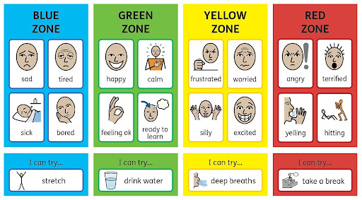
Behaviour and Discipline
We have high expectations of behaviour and learning.
Unwanted behaviour has consequences, such as missing Golden time or moving to a quiet space.
We spend time learning how to regulate our own feelings and learning how others feel too.
We teach children about the Zones of Regulation to understand how to get ready to learn (the green zone!)
We celebrate positive behaviour and learning choices – marble jar, stickers, celebration assembly and Christian values.

Slide 18

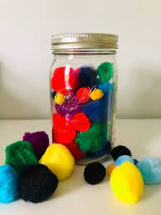
Christian Values
We promote good behaviour for learning and encourage positive choices through celebrating our Christian Values.
Courage
Respect
Compassion
Perseverance
Community
Wisdom
We also learn to celebrate our friends and compliment them on something they have done well.
We work as a team to add marbles or pompoms to the jar. When it is full we enjoy a class treat!

Slide 19

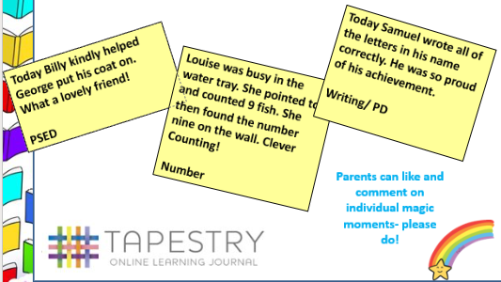
Tapestry

Slide 20

Class Dojo
This is the way you can send us a message and we can send announcements to you.
As your child continues through school this will replace Tapestry as a way of sharing photos and class events.

Slide 21
You can help by…
Promoting independence when going to the toilet, washing hands, eating with a knife and fork and by children getting changed by themselves (socks and tights are very tricky!)
Reading stories, poems and magazines with your children.
Playing maths games at home and count everything!
Encouraging correct pencil grip and control when colouring, drawing or writing.
Strengthen arm muscles by throwing and catching.

Slide 22

Thank you for listening.
We are really looking forward to your child joining Star Class!
Communication is key, please talk to us if you have any questions or worries.

