Slide 1
Reading
Welcome to the Star Class guide to reading!

Slide 2


Reading
Reading is so important. Once a child can read they can access everything in the curriculum so much more easily.
In early years we place phonics and reading as our priority. We will be concentrating on every child learning phonics. When they are ready, we will give them a reading book.
Please try and share a book with your child each day.

Slide 3

The Read Write Inc. Speed sounds lessons follow a careful progression, with sounds being introduced sequentially in a structured and systematic way. The broad order follows three sets:
Set 1 teaches the most common sound-letter correspondences:
m a s d t i n p g o c k u b f e l h sh r
j v y w th z ch qu x ng nk

Slide 4
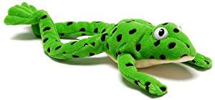
Set 2 Speed Sounds: ay ee igh ow oo oo ar or air ir ou oy
Set 3 Speed Sounds: ea oi a-e i-e o-e u-e aw are ur er ow ai oa ew ire ear ure
Glossary
Fred Talk – sounding out the word before reading (segmenting)
Green words – you can segment and blend these to say the word.
Red words – we learn these as a whole word, they don’t make sense phonetically.
sound-blending – putting sounds together to make a word, e.g. c–a–t cat (blending)
special friends – sounds written with more than one letter, sh, ng, qu, ch igh (digraphs or trigraphs)
Speed Sounds – the individual sounds that make up words (phonemes and graphemes)
Fred Talk – sounding out the word before reading (blending)
sound-blending – putting sounds together to make a word,
e.g. c–a–t cat
special friends – sounds written with more than one letter,
  sh, ng, qu, ch
Speed Sounds – the individual sounds that make up words
Fred Talk – sounding out the word before reading (blending)
sound-blending – putting sounds together to make a word,
e.g. c–a–t cat
special friends – sounds written with more than one letter,
  sh, ng, qu, ch
Speed Sounds – the individual sounds that make up words

Slide 5
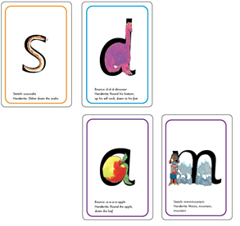
To find out more about the ‘Read Write Inc’ scheme please visit…
https://www.ruthmiskin.com/en/find-out-more/parents/
The more clearly and regularly you say the sounds, the more quickly your child will learn them.
Your child will bring home the Set 1 Speed Sounds.
You will see that each sound is drawn in the shape of a picture. For example:
• ‘s’ is in the shape of a snake
• ‘d’ is in the shape of a dinosaur
• ‘a’ is in the shape of an apple
• ‘m’ is in the shape of two mountains.
Important: We say ‘mmmm’ not ‘muh’ and ‘lllll’ not ‘luh’ when teaching the sounds. This really helps children when they learn to blend sounds together to read words.

Slide 6
Reading with a reading scheme book
When your child reads the story, ask him or her to sound out the words that he or she can’t read automatically.
This provides the skills to tackle any new words. The focus is to be able to read fluently. If a word is repeated, encourage your child to say this word straight away without needing to sound it out.
The more words children can recognise - the more confidence they will have to read.
Don’t allow your child to struggle too much.
Read back each sentence or page to keep the plot moving. (Your child’s energy is going into reading the words not the story.)
Always praise your child when he or she succeeds.

Slide 7

Effective reading with your child at home
The most important thing is to choose the right time to hear your child read when neither of you are too tired or busy.
10 minutes every day is far better than a laboured 30 minutes once a week.
Before reading start by warming the reading brain up with a few “speed sounds”.
Next, look at the title, blurb and picture.
What do you think the story will be about?
Which words might we be reading? Introduce any
tricky words/ character names before you start so
these are easier to remember.

Slide 8

Getting started
What is happening in the picture?
Let’s look at the tricky words on this page (spot these together before starting to read the whole sentence).
Continue in this way. If a sentence is laboured re-read it again for fluency and comprehension.
Remember that if your child can read the word they don’t need to sound it out they can just say it.
Our aim is to get the children to develop sight word fluency . This also aids comprehension.
When you have finished reading with your child ( this may be 3 pages only or the entire book) ask a few questions to check for understanding.
Always say what they have done well!
We want children to enjoy reading and have a
love of books and stories.

Slide 9
Every Read Write Inc Session
Using our RWInc programme we hear children read every day.
However ,it is so important they practise this skill every day at home in a calm, quiet and relaxed environment.
Our phonics part of the session starts with saying our letter sounds and our new speed sounds containing 2 or more letters - ay ee ch ow etc. We call these sounds special friends and we look for them in every long word we don’t know on sight.
Next we read our green words that contain letter sounds and special friends. We repeat for fluency.
We then read our new red words which are everyday high frequency words that you can’t sound out and are irregular, e.g. the I said he she we was
We then have a quick handwriting practice of individual letters working up to sentences.

Slide 10
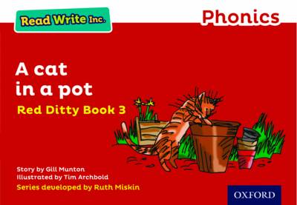
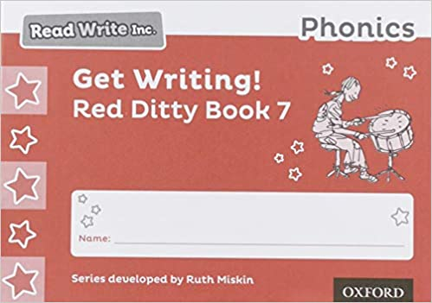
Moving our learning on
After the quick fire introduction we work with a partner to read our short story book.
First, we take it in turns to read in pairs and practise again our speed sounds and special friends.
Then we alternately read a page of our 3-4 page story in pairs with the teacher.
We have writing books that relate to the story and help us to develop our memory and comprehension skills. We then complete a written part of our booklet relating to the story.

Slide 11

ReadWriteInc. books at home
Each child will bring home the book they have been reading at school that week. They should be confident to read this to you. They will be able to read this book really well because they have practised at school.
Ruth Miskin advises that families should avoid saying “this book is too easy for you” as your child can read well because they have worked hard and their fluency will improve with each read.
Unlike their individual book, that you can change on any day, please keep this book in their book bag as we will need to change it on the relevant day for their group.

Slide 12
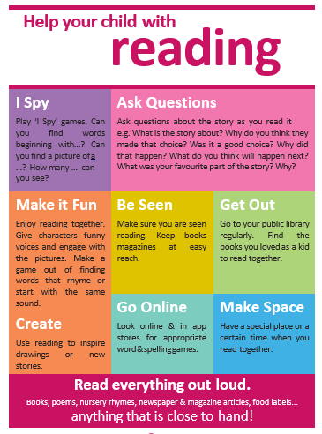

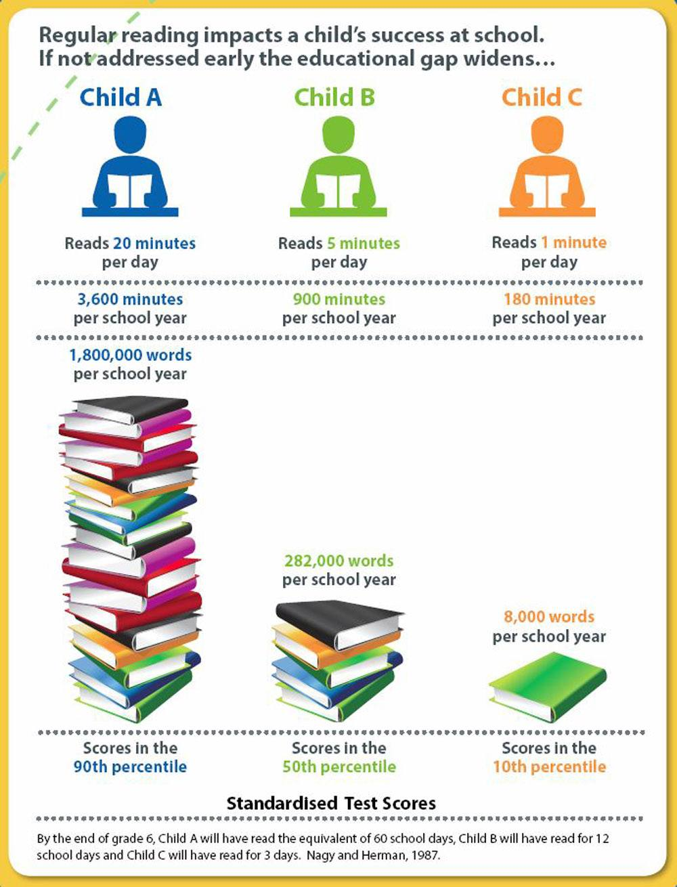
Thank you for all your support, it really makes a positive difference to your child’s learning

