Slide 1


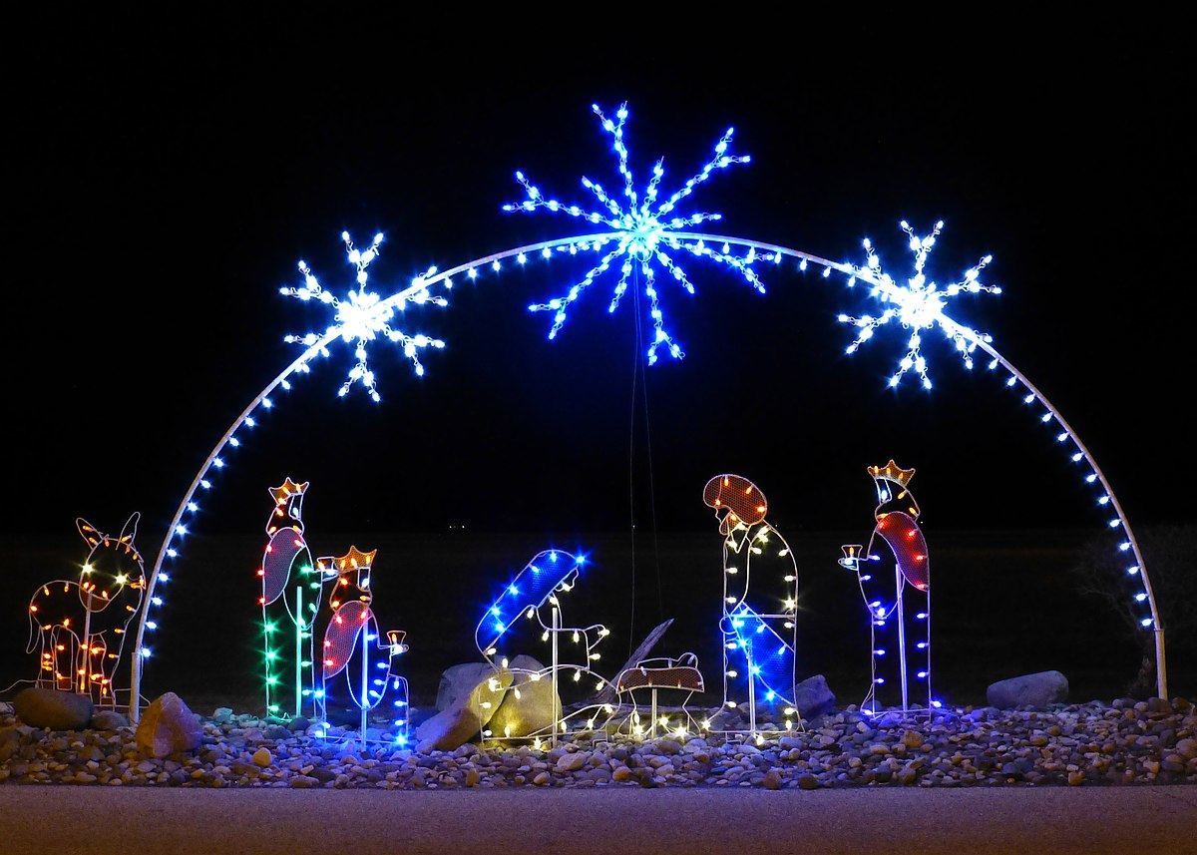
Star Class Homework - Autumn Term
Make a Christmas decoration . You can use any different type of material, for example wool, cotton, twigs, hamma beads etc. Can you hang it up?
Make a shape picture using lots of different shapes. It could be in the form of a firework, Christmas decorations or an autumn picture.
Celebrations
Make a clay Diva Lamp. You could paint it or decorate it with sequins and beads.
Using an iPad or computer find out how other countries celebrate Christmas.
Please choose 2 activities to complete
this half term. Please place one on Tapestry and bring one into school to
share with the class – WB-5th December before the Homework Exhibition
(Thursday 8th December).
Design and write a party invitation. Remember to include all the information.
Bake some Christmas, Thanksgiving or Diwali biscuits and decorate them. Can you take a photo to bring in and show us?
This Photo by Unknown Author is licensed under CC BY-NC
Design make and write a birthday or Christmas card for a friend or family member.

